Slide 1

Clicker Questions
Chapter 4
Atoms and
Covalent Bonds
Donald Linn
Indiana University–
Purdue University Fort Wayne
Fort Wayne, IN
© 2014 Pearson Education, Inc.

Slide 2
Which is expected to have the largest carbon–oxygen bond dissociation energy?
a) CO
b) CO₂
c) HCO₂H
d) CO₃^{2–}
e) All about the same
© 2014 Pearson Education, Inc.
Notes:
Answer: a

Slide 3
Which is expected to have the largest carbon–oxygen bond dissociation energy?
a) CO
b) CO₂
c) HCO₂H
d) CO₃^{2–}
e) All about the same
© 2014 Pearson Education, Inc.
Notes:
Answer: a

Slide 4
Which is expected to have the longest bond?
a) H₃C–CH₃
b) H₂C=CH₂
c) F₂C=CF₂
d) HC≡CH
e) All about the same
© 2014 Pearson Education, Inc.
Notes:
Answer: a

Slide 5
Which is expected to have the longest bond?
a) H₃C–CH₃
b) H₂C=CH₂
c) F₂C=CF₂
d) HC≡CH
e) All about the same
© 2014 Pearson Education, Inc.
Notes:
Answer: a

Slide 6
The electronegativity is 2.1 for H and 1.8 for Si. Based on these electronegativities, SiH₄ would be expected to
a) be ionic and contain H– ions.
b) be ionic and contain H⁺ ions.
c) have polar covalent bonds with a partial negative charges on the H atoms.
d) have polar covalent bonds with a partial positive charges on the H atoms.
e) None of the above
© 2014 Pearson Education, Inc.
Notes:
Answer: c

Slide 7
The electronegativity is 2.1 for H and 1.8 for Si. Based on these electronegativities, SiH₄ would be expected to
a) be ionic and contain H– ions.
b) be ionic and contain H⁺ ions.
c) have polar covalent bonds with a partial negative charges on the H atoms.
d) have polar covalent bonds with a partial positive charges on the H atoms.
e) None of the above
© 2014 Pearson Education, Inc.
Notes:
Answer: c

Slide 8
The formula for dinitrogen trioxide is
a) N(OH)₃.
b) (NO₃)₂.
c) N₂O₃.
d) N₃O₂.
e) None of the above
© 2014 Pearson Education, Inc.
Notes:
Answer: c

Slide 9
The formula for dinitrogen trioxide is
a) N(OH)₃.
b) (NO₃)₂.
c) N₂O₃.
d) N₃O₂.
e) None of the above
© 2014 Pearson Education, Inc.
Notes:
Answer: c

Slide 10
The formula for N₂O is
nitrate.
nitrite.
dinitrogen monoxide.
nitrogen(I) oxide.
None of the above
© 2014 Pearson Education, Inc.
Notes:
Answer: c

Slide 11
The formula for N₂O is
nitrate.
nitrite.
dinitrogen monoxide.
nitrogen(I) oxide.
None of the above
© 2014 Pearson Education, Inc.
Notes:
Answer: c

Slide 12
How many of the σ bonds in H₂SO₄ are coordinate covalent bonds?
0
2
4
6
8
© 2014 Pearson Education, Inc.
Notes:
Answer: b

Slide 13
How many of the σ bonds in H₂SO₄ are coordinate covalent bonds?
0
2
4
6
8
© 2014 Pearson Education, Inc.
Notes:
Answer: b

Slide 14
Which molecule contains a triple bond?
F₂
O₃
HCN
H₂CO
None of the above
© 2014 Pearson Education, Inc.
Notes:
Answer: c

Slide 15
Which molecule contains a triple bond?
F₂
O₃
HCN
H₂CO
None of the above
© 2014 Pearson Education, Inc.
Notes:
Answer: c

Slide 16
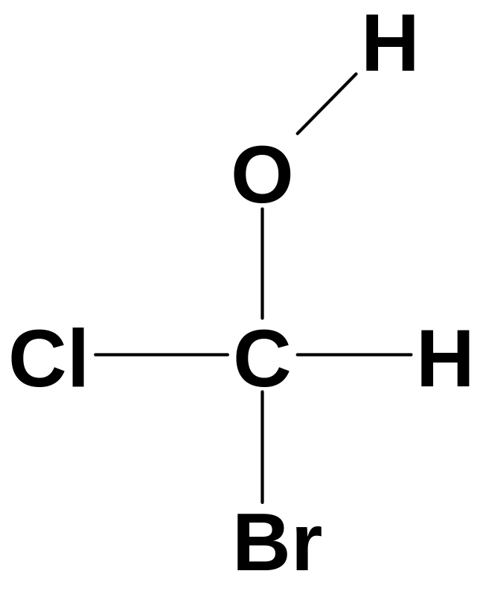
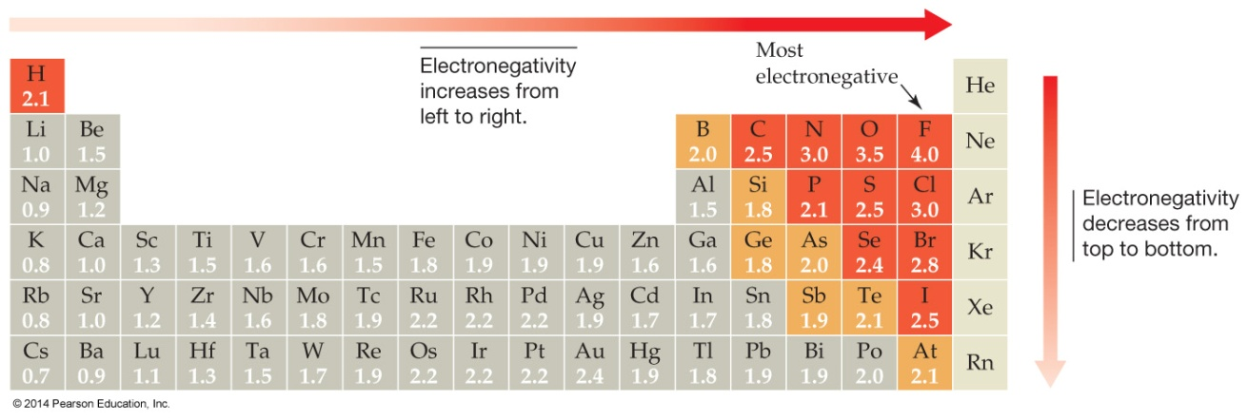
Which of the bonds in chlorofluoromethanol is
most polar?
a
b
d
c
e
© 2014 Pearson Education, Inc.
Notes:
Answer: a

Slide 17
Which of the bonds in chlorofluoromethanol is
most polar?
a
b
d
c
e
© 2014 Pearson Education, Inc.
Notes:
Answer: a

Slide 18
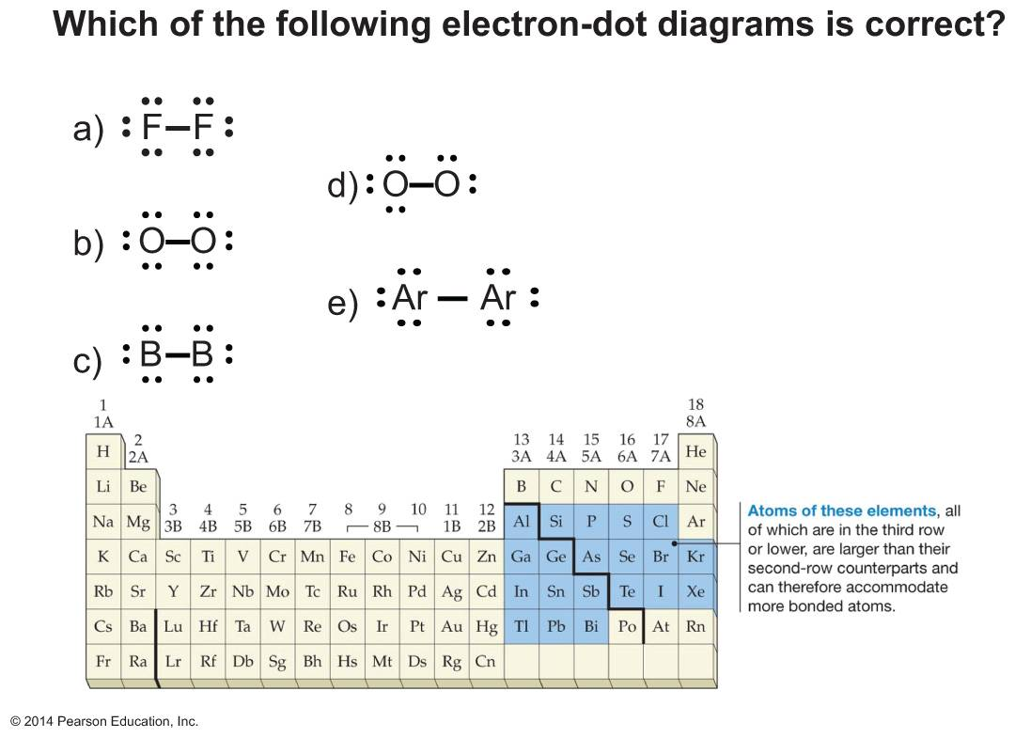
© 2014 Pearson Education, Inc.
Notes:
Answer: a

Slide 19

© 2014 Pearson Education, Inc.
Notes:
Answer: a

Slide 20
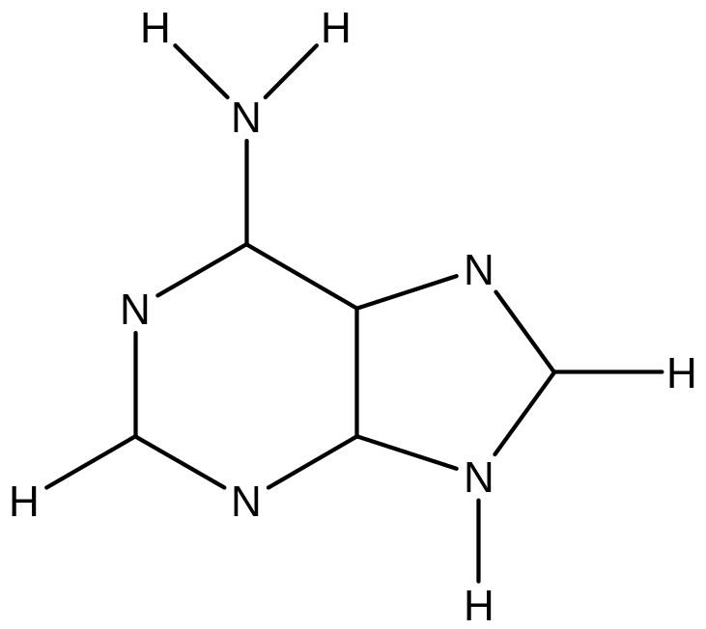
The structure to the right shows the connectivity of the atoms in adenine.
The number of double bonds and lone electron pairs, respectively, are
a) 3, 4.
d) 4, 5.
b) 4, 3.
e) 5, 5.
c) 4, 4.
© 2014 Pearson Education, Inc.
Notes:
Answer: d

Slide 21
The structure to the right shows the connectivity of the atoms in adenine.
The number of double bonds and lone electron pairs, respectively, are
a) 3, 4.
d) 4, 5.
b) 4, 3.
e) 5, 5.
c) 4, 4.
© 2014 Pearson Education, Inc.
Notes:
Answer: d

Slide 22
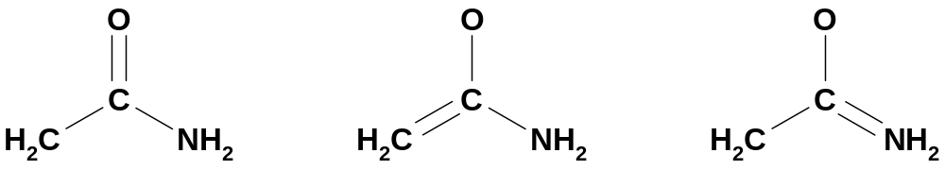
Below are three resonance structures for
C-deprotonated acetamide (i.e., an anion).
A
B
C
Which of the following is the correct order of “best to
worst” resonance structures based on formal charges?
a) A > B > C
b) A > C > B
c) B > A > C
d) B > C > A
e) C > B > A
© 2014 Pearson Education, Inc.
Notes:
Answer: c

Slide 23
Below are three resonance structures for
C-deprotonated acetamide (i.e., an anion).
A
B
C
Which of the following is the correct order of “best to
worst” resonance structures based on formal charges?
a) A > B > C
b) A > C > B
c) B > A > C
d) B > C > A
e) C > B > A
© 2014 Pearson Education, Inc.
Notes:
Answer: c

Slide 24
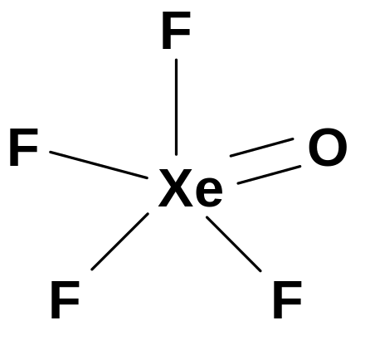
To the right is the electron-dot structure for XeOF₄. What is the geometry of the molecule?
a) Trigonal pyramidal
b) Trigonal bipyramidal
c) Square pyramidal
d) Octahedral
e) Tetrahedral
© 2014 Pearson Education, Inc.
Notes:
Answer: c

Slide 25
To the right is the electron-dot structure for XeOF₄. What is the geometry of the molecule?
a) Trigonal pyramidal
b) Trigonal bipyramidal
c) Square pyramidal
d) Octahedral
e) Tetrahedral
© 2014 Pearson Education, Inc.
Notes:
Answer: c

Slide 26
Assign formal charges to each atom in the following resonance forms and decide which is the correct order of “best to worst” resonance structures for N₂O.
A.
B.
C.
a) A > B > C
b) A > C > B
c) B > A > C
d) B > C > A
e) C > B > A
© 2014 Pearson Education, Inc.
Notes:
Answer: c

Slide 27
Assign formal charges to each atom in the following resonance forms and decide which is the correct order of “best to worst” resonance structures for N₂O.
A.
B.
C.
a) A > B > C
b) A > C > B
c) B > A > C
d) B > C > A
e) C > B > A
© 2014 Pearson Education, Inc.
Notes:
Answer: c

Slide 28
Draw the Lewis structure for XeF₄.
F
F
a)
F
Xe
F
c)
F
Xe
F
F
F
Which Lewis structure to the right is correct?
F
F
b)
d)
F
Xe
F
F
Xe
F
F
F
© 2014 Pearson Education, Inc.
Notes:
Answer: c

Slide 29
Draw the Lewis structure for XeF₄.
F
F
a)
F
Xe
F
c)
F
Xe
F
F
F
Which Lewis structure to the right is correct?
F
F
b)
d)
F
Xe
F
F
Xe
F
F
F
© 2014 Pearson Education, Inc.
Notes:
Answer: c

Slide 30
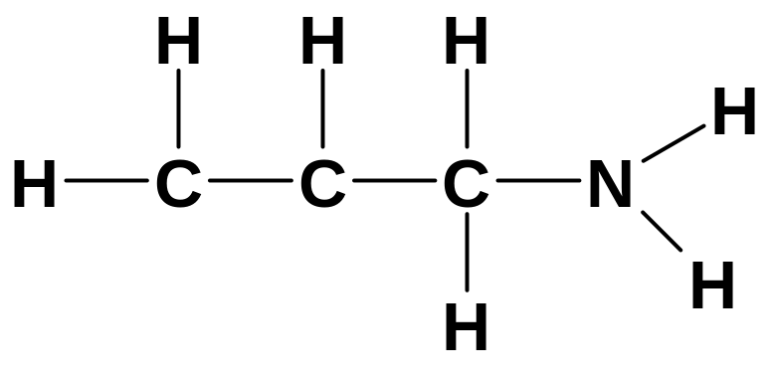
The structure to the right shows the connectivity of the atoms in an unsaturated amine.
The number of double bonds and lone electron pairs, respectively, are
a) 1, 1.
d) 2, 2.
b) 1, 2.
e) 1, 3.
c) 2, 1.
© 2014 Pearson Education, Inc.
Notes:
Answer: a

Slide 31
The structure to the right shows the connectivity of the atoms in an unsaturated amine.
The number of double bonds and lone electron pairs, respectively, are
a) 1, 1.
d) 2, 2.
b) 1, 2.
e) 1, 3.
c) 2, 1.
© 2014 Pearson Education, Inc.
Notes:
Answer: a

Slide 32
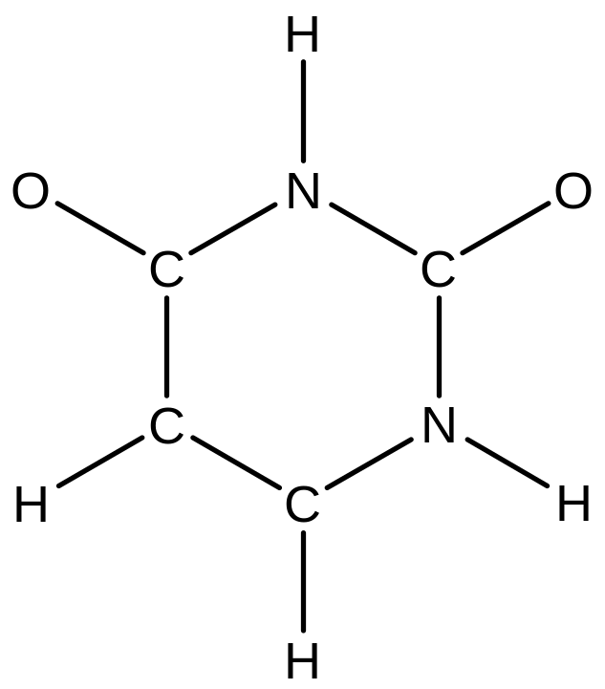
The structure to the right shows the connectivity of the atoms in uracil. The number of double bonds and lone electron pairs, respectively, are
a) 1, 2.
d) 3, 4.
b) 2, 2.
e) 3, 6.
c) 2, 4.
© 2014 Pearson Education, Inc.
Notes:
Answer: e

Slide 33
The structure to the right shows the connectivity of the atoms in uracil. The number of double bonds and lone electron pairs, respectively, are
a) 1, 2.
d) 3, 4.
b) 2, 2.
e) 3, 6.
c) 2, 4.
© 2014 Pearson Education, Inc.
Notes:
Answer: e

